Slide 1
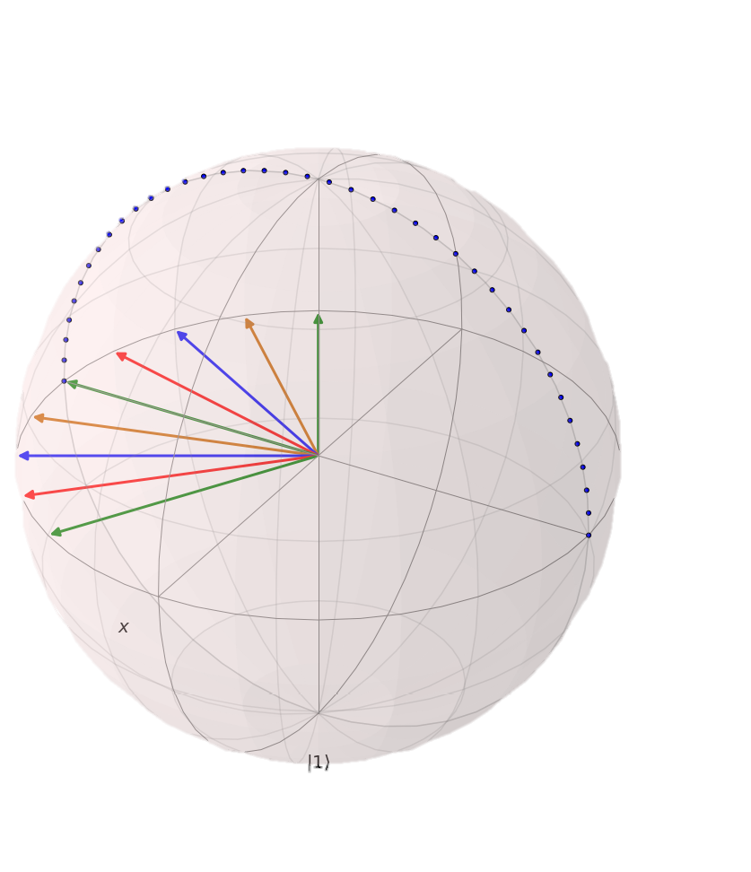

Dynamic Decoupling Boaz Raz Nir Davidson and Roee Ozeri group
MICE Student Conference 2019
Molecules, trapped Ions & Cold atom Engineering
November 21st 2019

Slide 2
Outline
Experimental system
Robust population measuring technique – Normalized detection
Microwave control and Ramsey experiment
Precision spectroscopy, decoherence and noise
Dynamical decoupling techniques
Understanding noise and their sources
Demonstration of how we use it

Slide 3
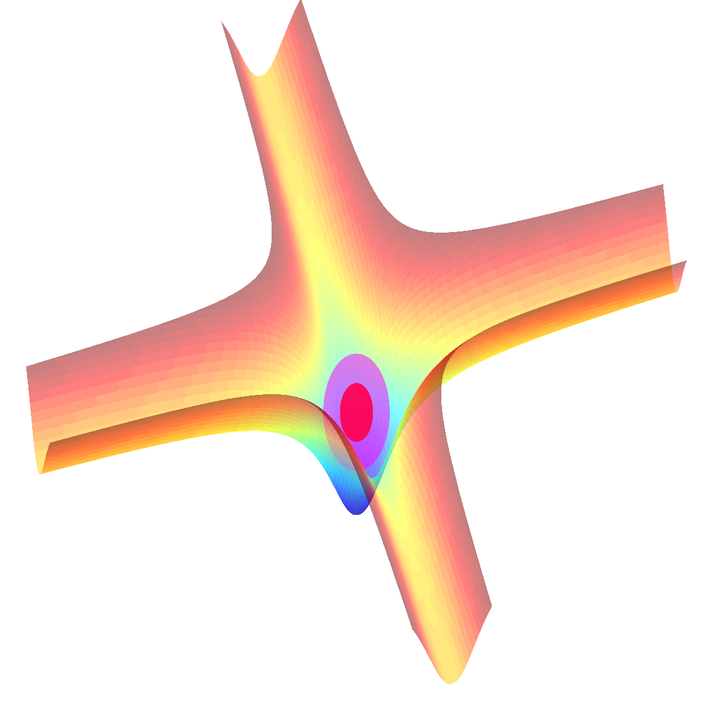
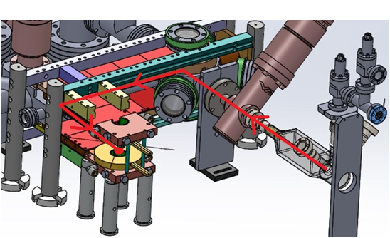
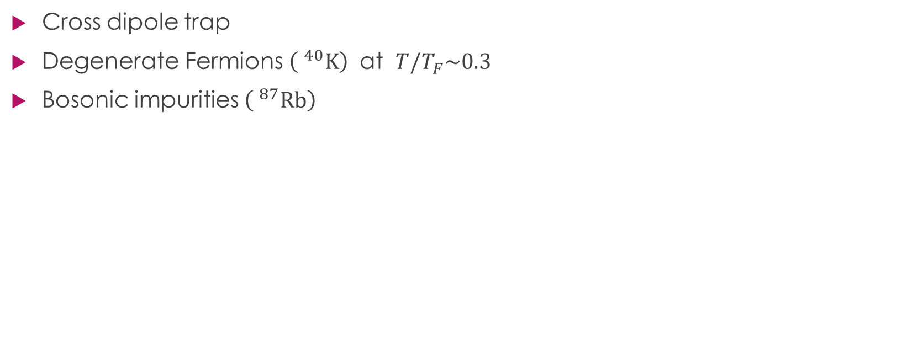
Experimental System
Cross dipole trap
Degenerate Fermions $\left( ^{40}K\right)$ at $T/T_{F}\sim 0.3$
Bosonic impurities $\left( ^{87}Rb\right)$
Bose – Fermi mixture
in a cross dipole trap
Magnetic Transport
3D MOT
QUIC +
Dipole Trap
2D MOT

Slide 4
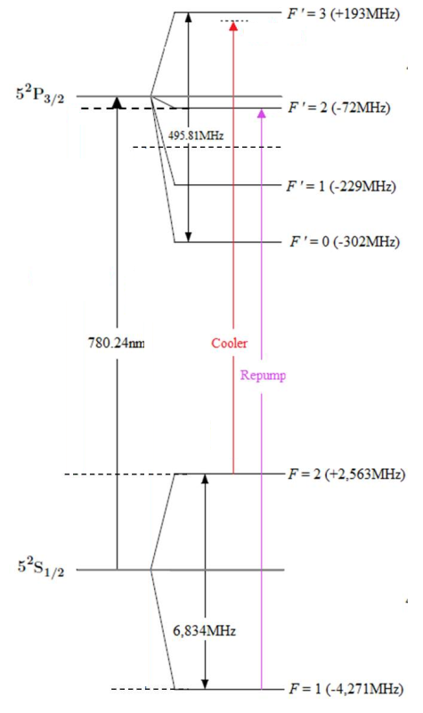
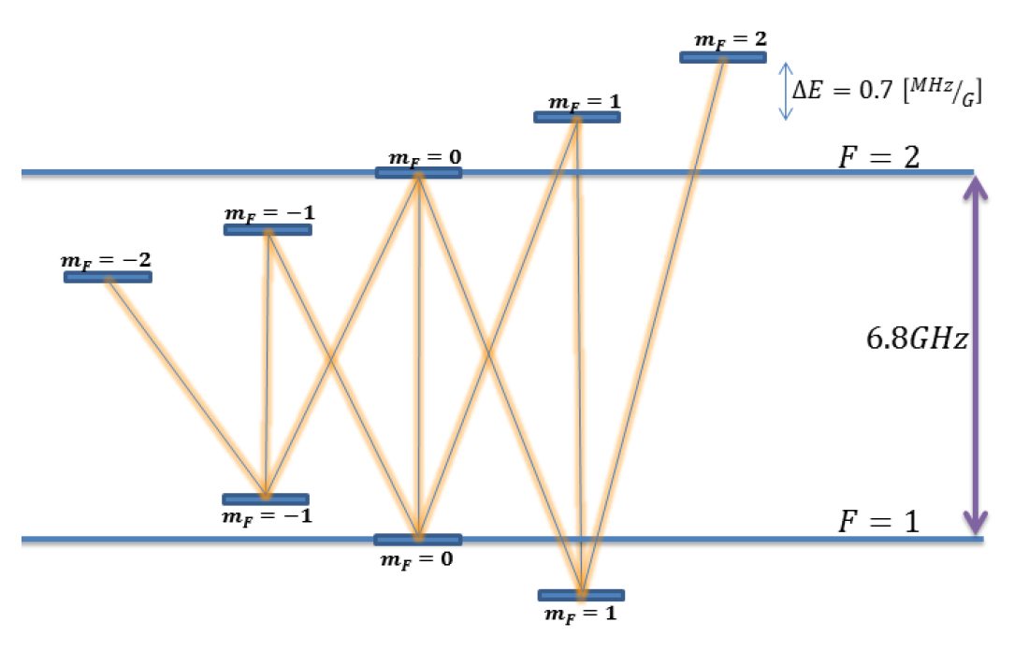
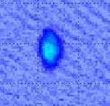
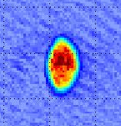

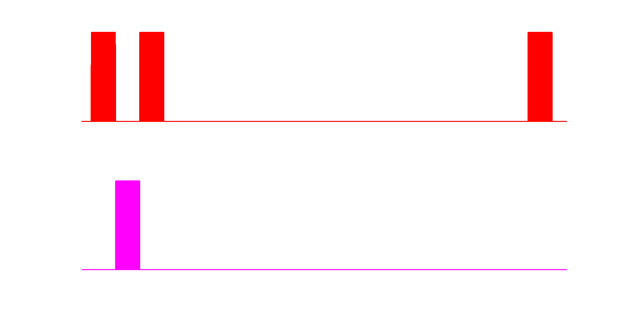
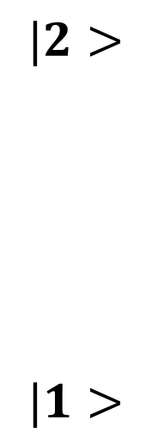
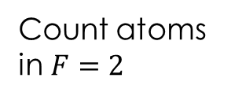
Normalized Detection
$$|2>$$
$$|1>$$
Count atoms in $F=2$
Count all atoms
Reference
Imaging
Repump

Slide 5
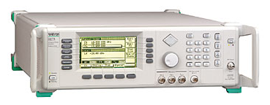
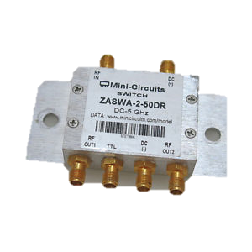
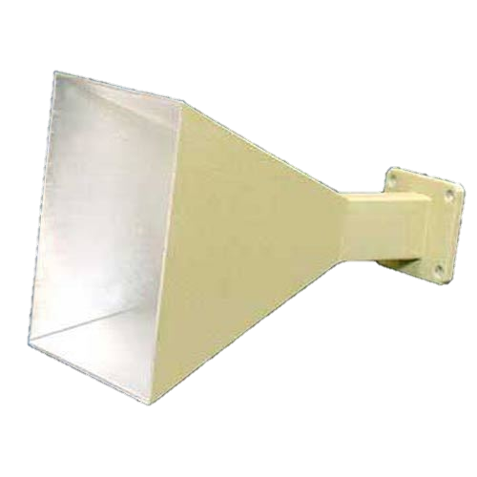
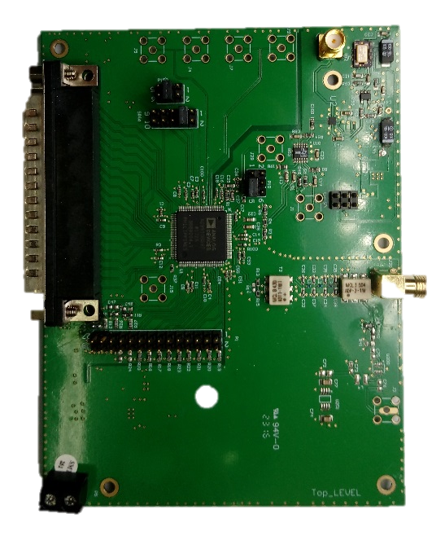

Microwave Control
Microwave generator
Switch
Amplfier
DDS
(Meir)
FPGA

Slide 6
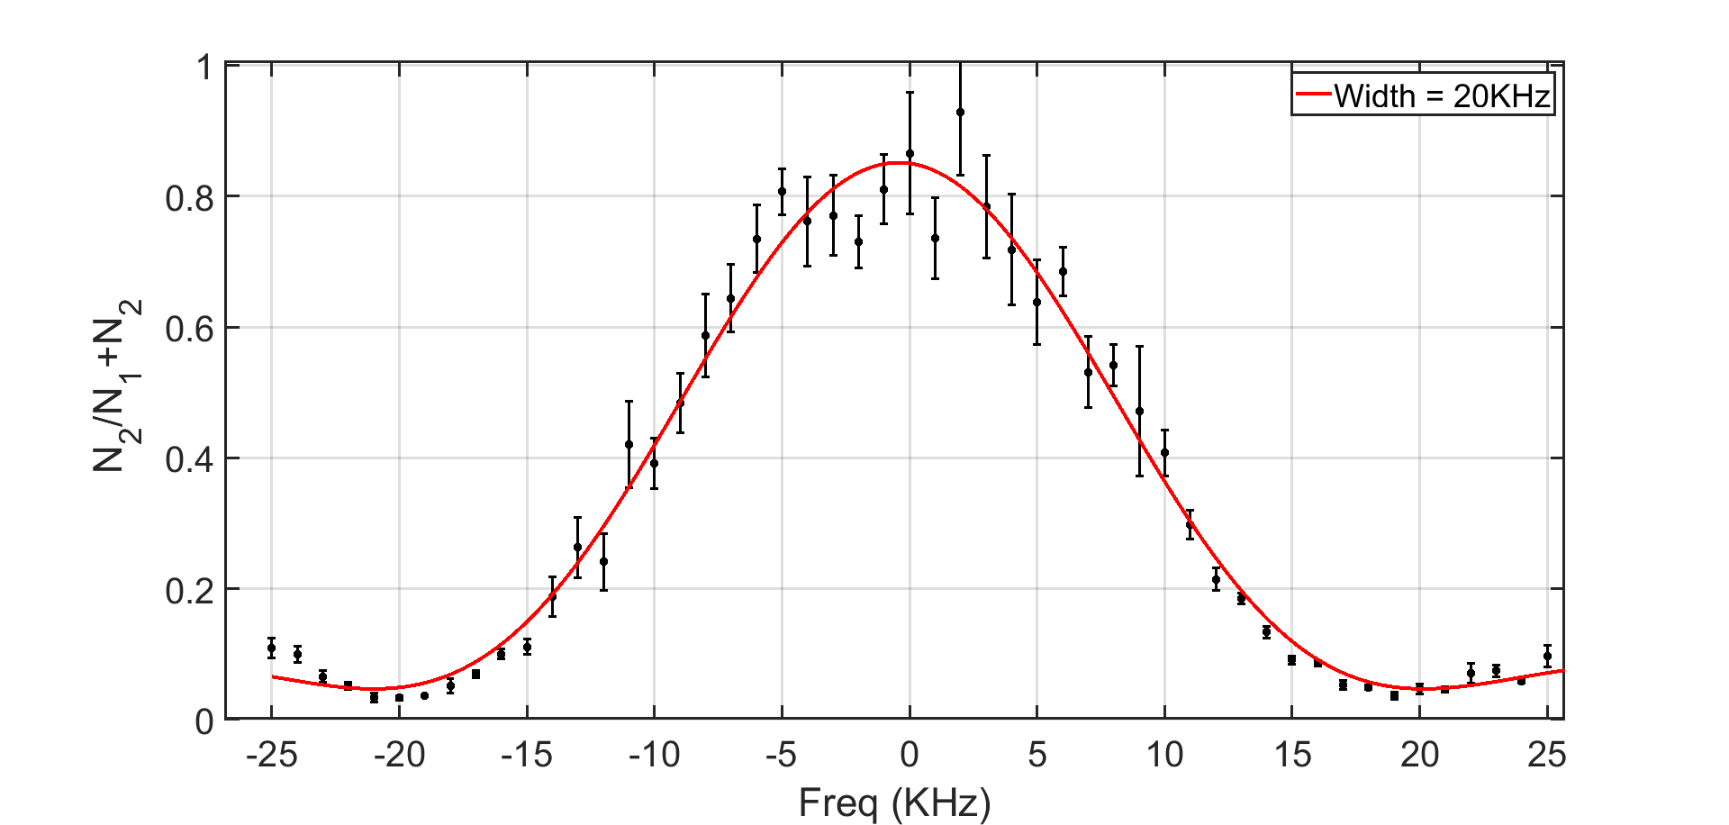
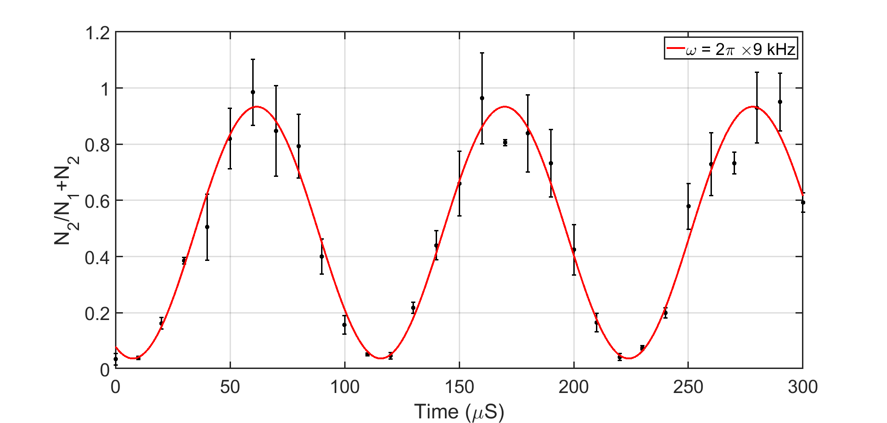

$^{87}Rb$ Microwave Rabi oscillations

Slide 7
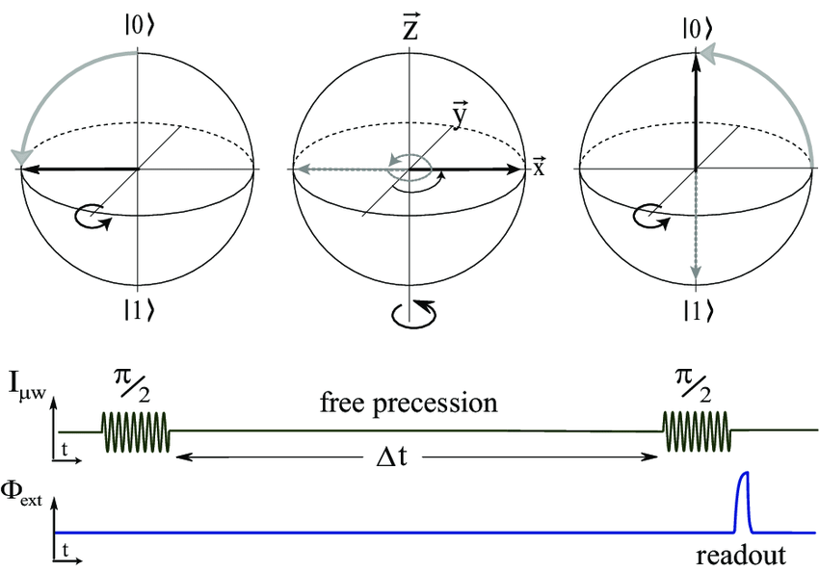
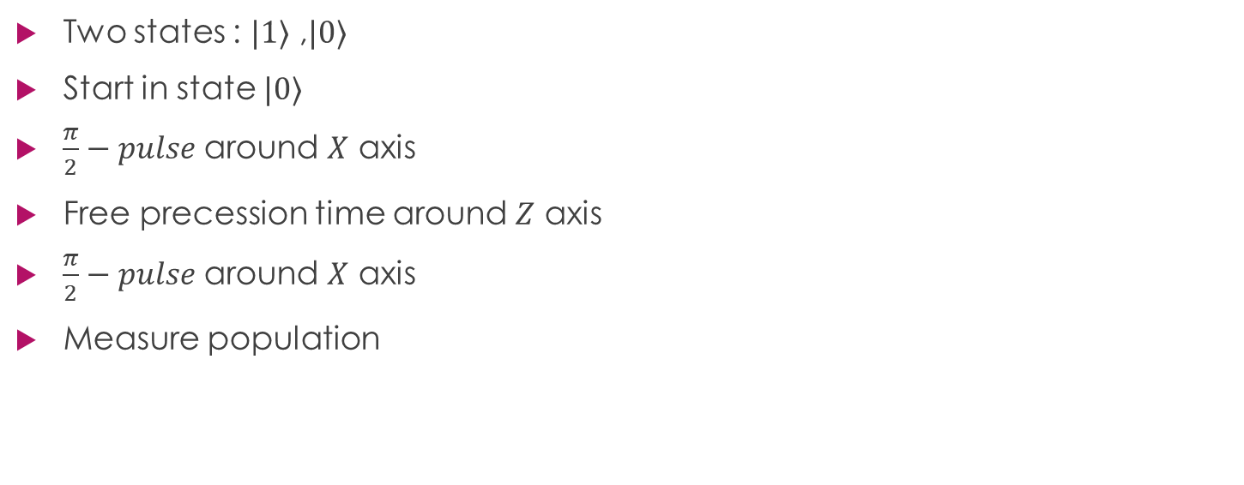
Ramsey Experiment
Two states : $|1⟩$ ,$|0⟩$
Start in state $|0⟩$
$\frac{π}{2}−pulse$ around $X$ axis
Free precession time around $Z$ axis
$\frac{π}{2}−pulse$ around $X$ axis
Measure population

Slide 8
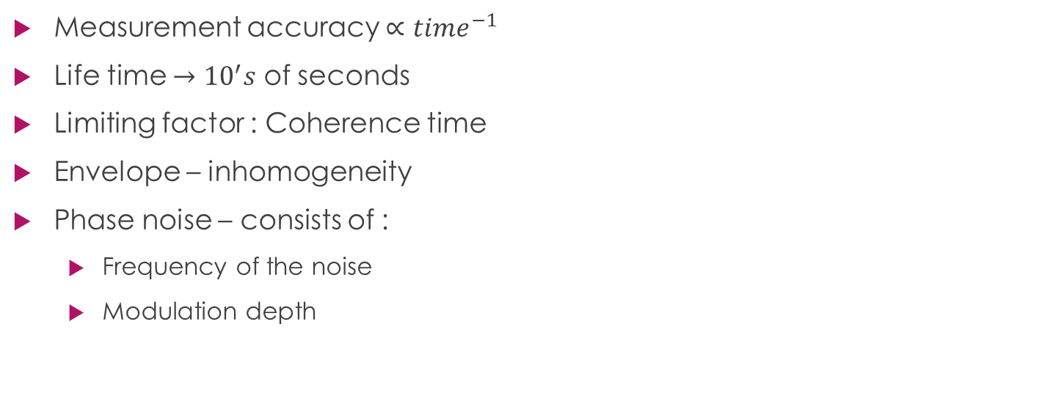
Precision Spectroscopy
Ramsey Experiment
Measurement accuracy $∝time^{−1}$
Life time $→{10}^{′}s$ of seconds
Limiting factor : Coherence time
Envelope – inhomogeneity
Phase noise – consists of :
Frequency of the noise
Modulation depth

Slide 9
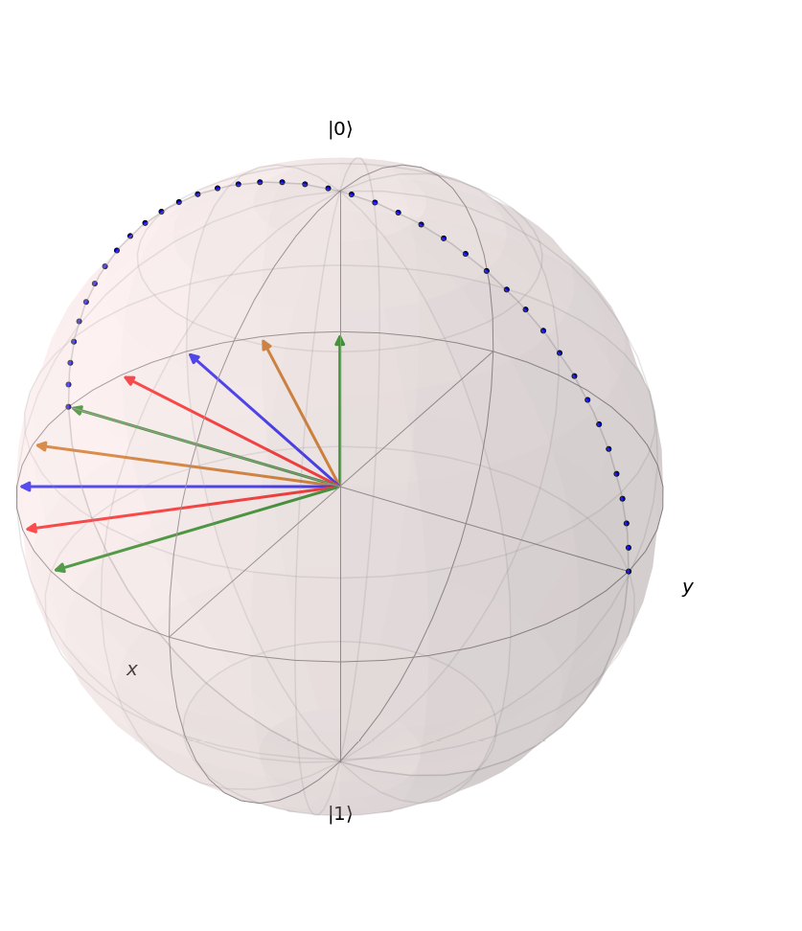
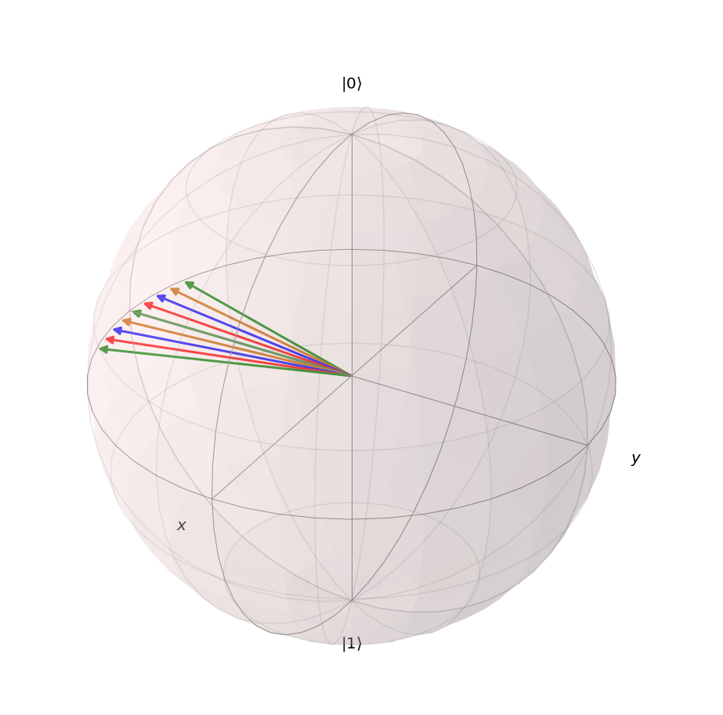
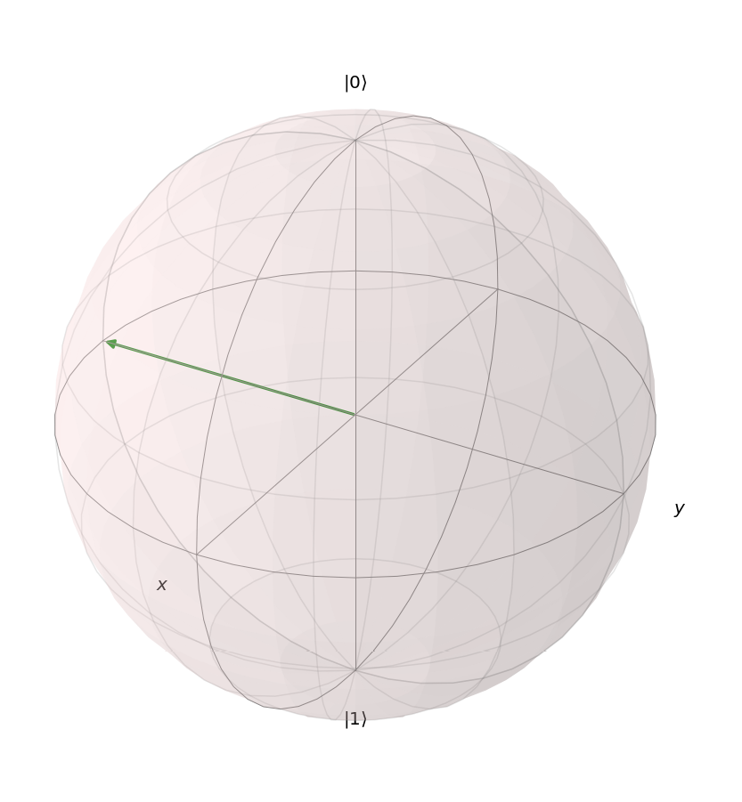
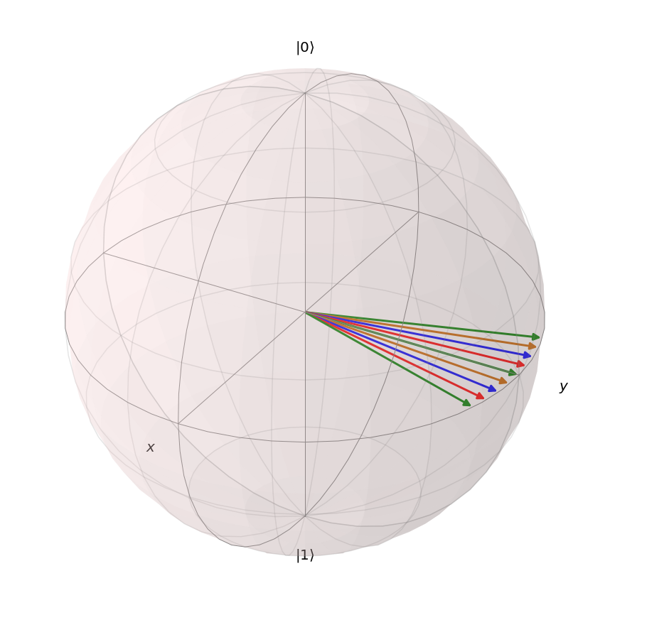
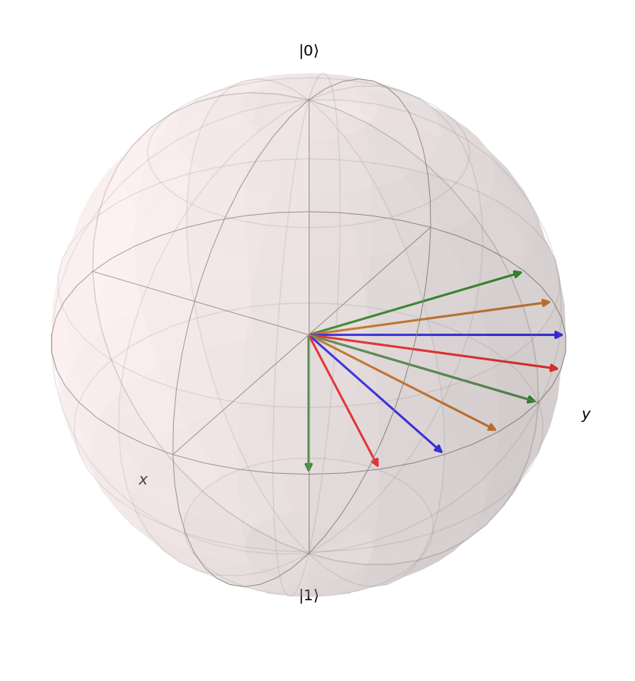
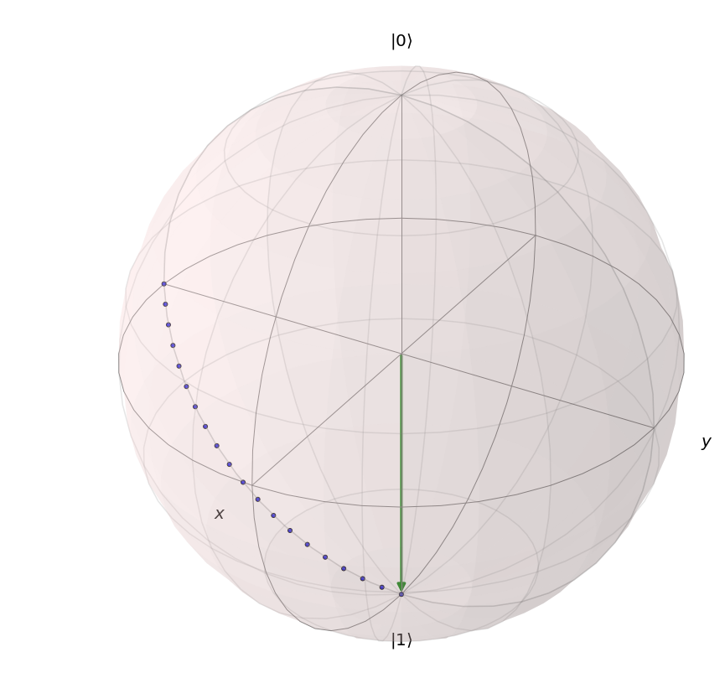
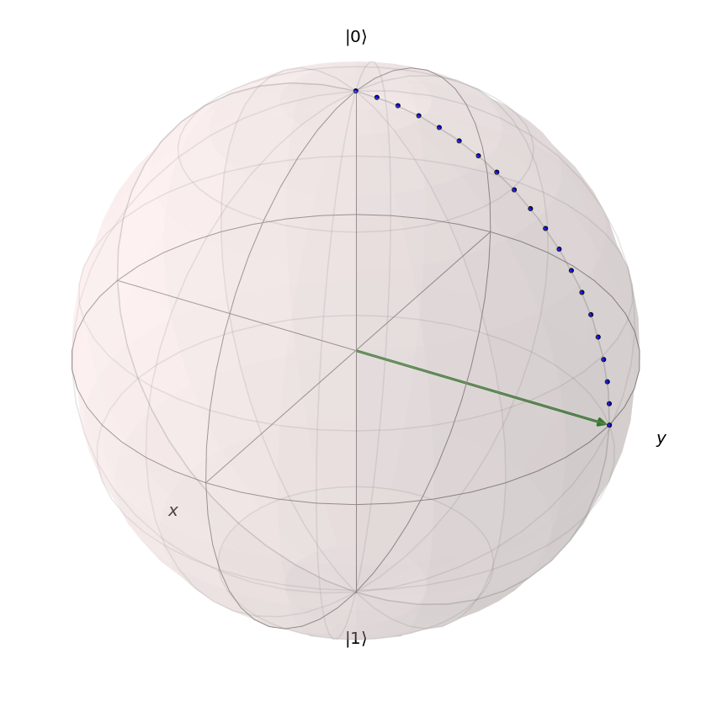
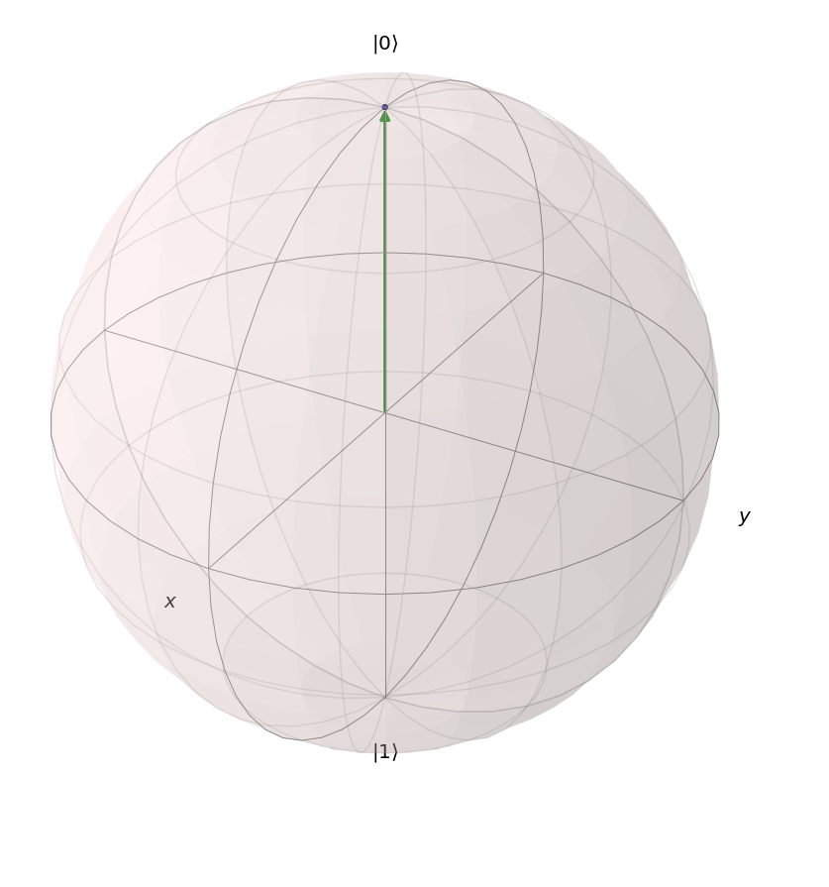
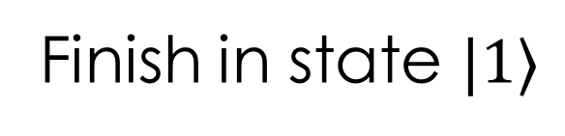



Pulse Echo - Revive
Start in state $|0⟩$
$$\frac{π}{2} pulse$$
Finish in state $|1⟩$
evolution
$$π pulse$$

Slide 10
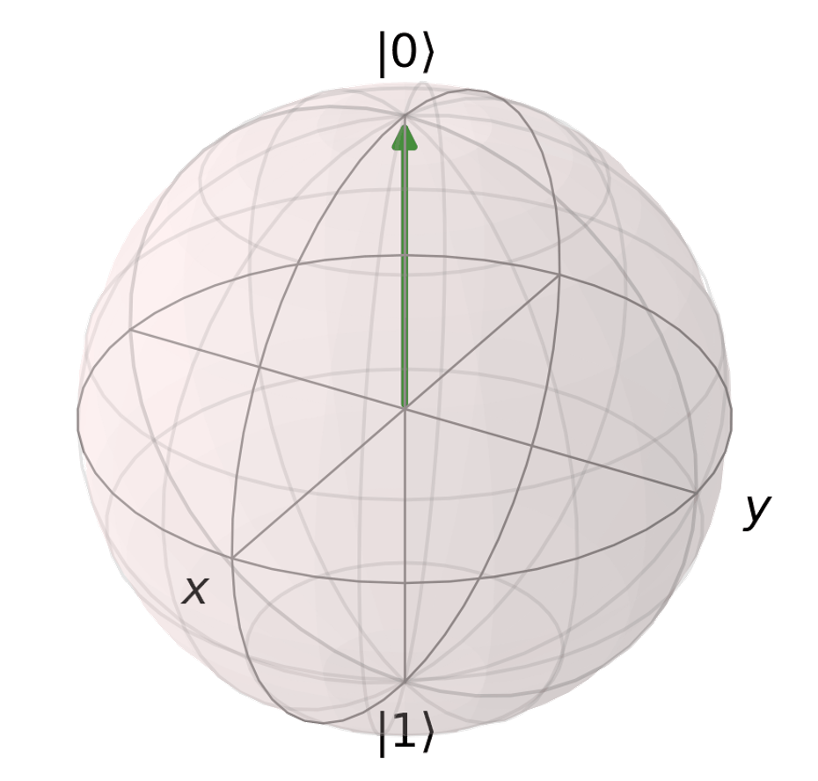
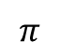
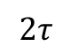
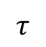
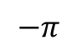
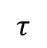
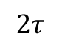
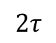
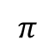
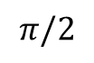
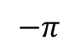
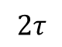
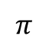
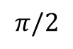
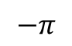
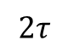
Dynamic Decoupling (DD)
$$π/2$$
$$−π$$
$$π$$
$$−π$$
$$π$$
$$−π$$
$$π$$
$$π/2$$
$$τ$$
$$2τ$$
$$2τ$$
$$2τ$$
$$2τ$$
$$2τ$$
$$τ$$

Slide 11
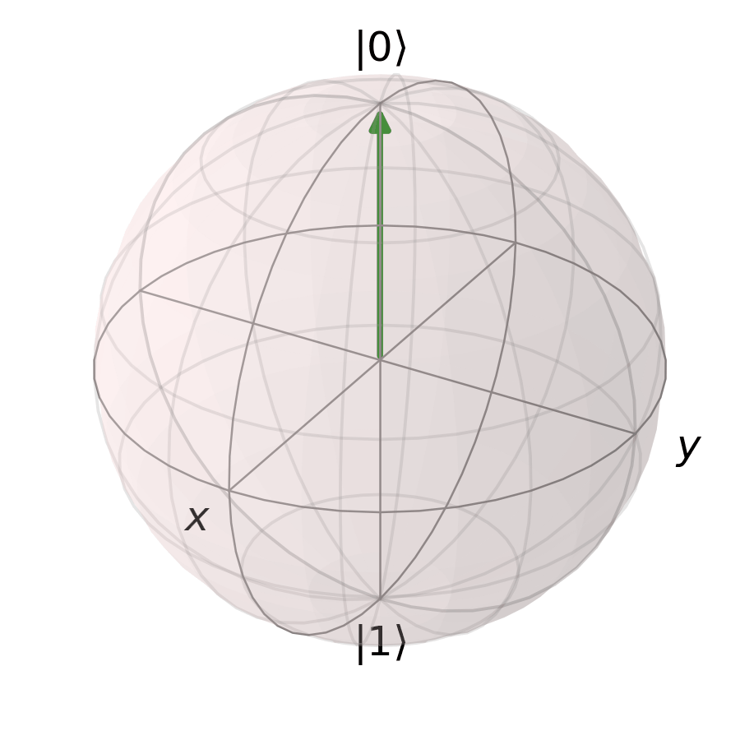
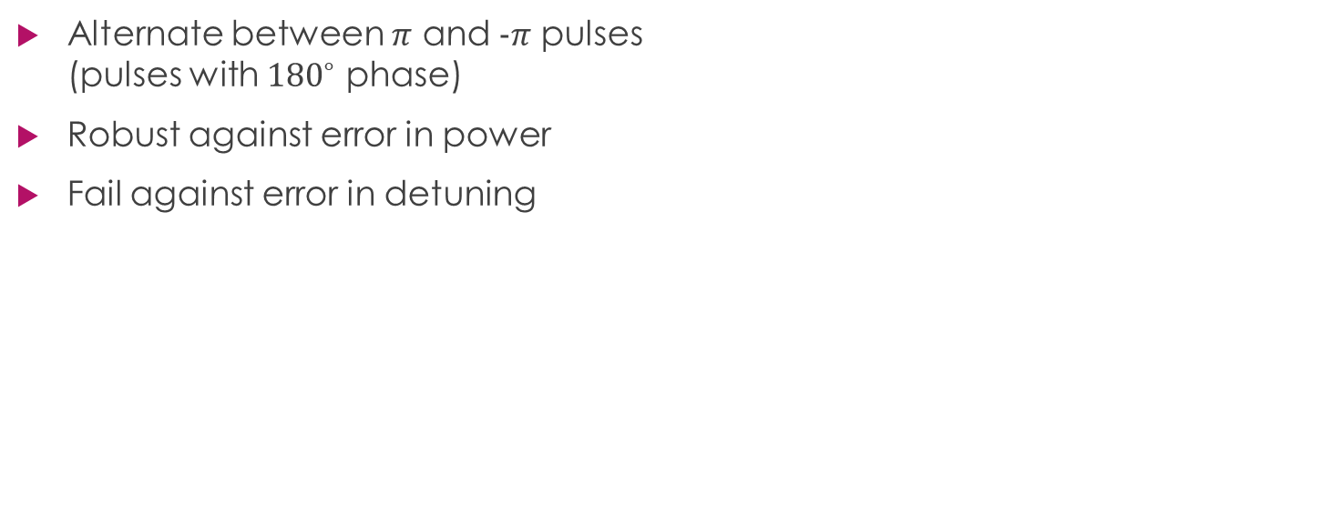
Dynamic Decoupling (DD)
Alternate between $π$ and $−π$ pulses (pulses with ${180}^{∘}$ phase)
Robust against error in power
Fail against error in detuning
$$π/2$$
$$−π$$
$$π$$
$$−π$$
$$π$$
$$−π$$
$$π$$
$$π/2$$
$$τ$$
$$2τ$$
$$2τ$$
$$2τ$$
$$2τ$$
$$2τ$$
$$τ$$

Slide 12
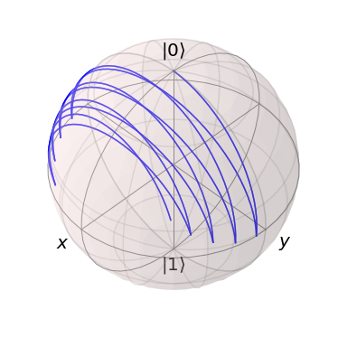
Error in The Control
Detuning
Power

Slide 13
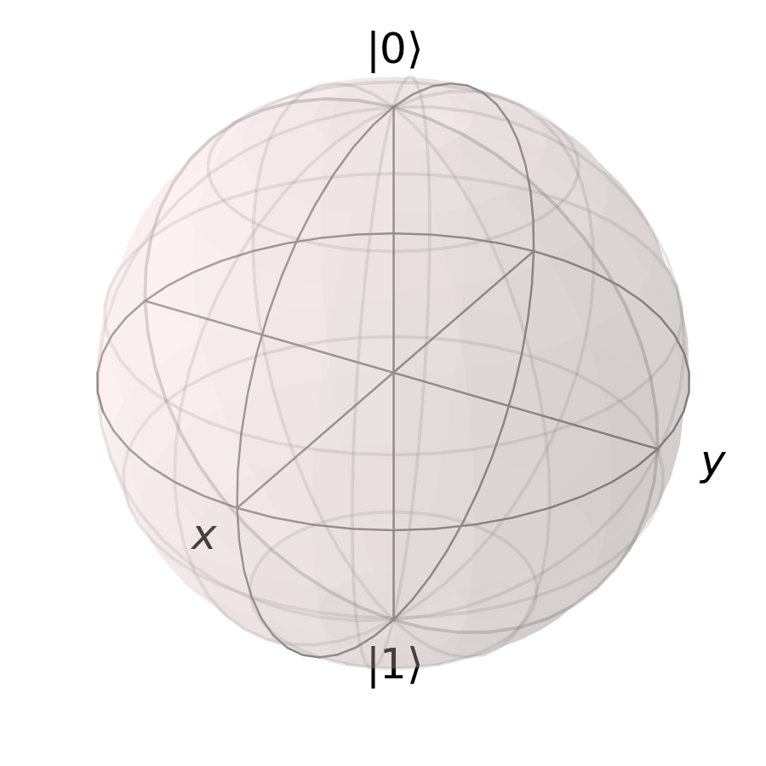
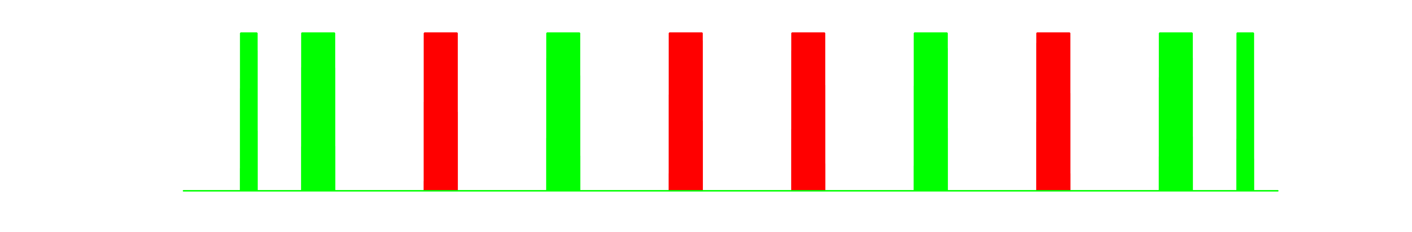



















XY8 Sequence
Robust against erro in detuning
Also robust against error in power
$$π/2$$
$$X$$
$$Y$$
$$X$$
$$Y$$
$$Y$$
$$X$$
$$Y$$
$$X$$
$$π/2$$
$$τ$$
$$2τ$$
$$2τ$$
$$2τ$$
$$2τ$$
$$2τ$$
$$2τ$$
$$2τ$$
$$τ$$

Slide 14




Understanding noise and measuring 50 Hz Noise
Ramsey Time $800μs$
Sync DD sequence to 50Hz
Scan Ramsey pulses sync time
Measure Ramsey oscillation

Slide 15








Unbalanced Ramsey –
Twist measurement
$Population =\frac{N_{2}}{N_{tot}}=\frac{1}{4}\left(3+\cos\left(2θ\right)+2sin^{2}\left(θ\right)\cos\left(φ+Δφ_{R}\right)\right)$
$Δφ_{R}=\frac{2πℏ}{m}\left(\left(a_{22}−a_{11}\right)n+\left(a_{11}+a_{22}−2a_{12}\right)δn\right)T_{ }$ $n=n_{1}+n_{2}, δn=n_{2}−n_{1}$
$$\left|\left.2\right\rangle \right.$$
$$\left|\left.1\right\rangle \right.$$
$$θ$$
$$\left(π−θ\right)$$
$$T_{ }$$

Slide 16










Twist Measurement – Enhanced by DD
$$N_{Echos}$$
$$θ$$
$$−π$$
$$π$$
$$π−θ$$
$$T$$
$Δφ_{R}=\frac{2πℏ}{m}\left(\left(a_{22}−a_{11}\right)n+\left(a_{11}+a_{22}−2a_{12}\right)δn\right)T_{ }$
$a_{22}−a_{11}≈5a_{0} but a_{11}+a_{22}−2a_{12}≈0.5a_{0}$ So this is a hard measurement
With Echo pulses we flip the populations, cancel the first term and accumulate the last: $Δφ_{DD}=\frac{4πℏ}{m}\left(a_{11}+a_{22}−2a_{12}\right)δnN_{Echo}T_{ }$
$$T$$
$$2T$$

Slide 17
Twist Measurements

Slide 18
Summary
Dynamical Decoupling can overcome major noise mechanisms
Increased coherence times allow for precision spectroscopy
More complex DD schemes can be robust to errors in the control as well
It is very important to understand the particular noise characteristics in your lab

Slide 19



Slide 20
XY8 Sequence
Robust against error in detuning
Also robust against error in power
$$π/2$$
$$X$$
$$Y$$
$$X$$
$$Y$$
$$Y$$
$$X$$
$$Y$$
$$X$$
$$π/2$$
$$τ$$
$$2τ$$
$$2τ$$
$$2τ$$
$$2τ$$
$$2τ$$
$$2τ$$
$$2τ$$
$$τ$$

